Slide 1


NEUROFORGE ENTERPRISE
SDLC
PLATFORM
PREPARED BY :
PRAVEEN KUMAR RAMESH

Slide 2
WHAT IS NEUROFORGE ENTERPRISE SDLC PLATFORM?
NeuroForge Enterprise SDLC Platform is an AI-powered Software Development Life Cycle (SDLC) platform that helps organizations manage the complete software development process in one integrated environment. It enables project managers, business analysts, developers, testers, DevOps engineers, and stakeholders to collaborate efficiently throughout the software lifecycle.
Instead of using multiple disconnected tools for project management, coding, testing, deployment, and monitoring, NeuroForge provides a unified platform that integrates these activities while leveraging Artificial Intelligence to automate repetitive tasks and improve productivity.

Slide 3
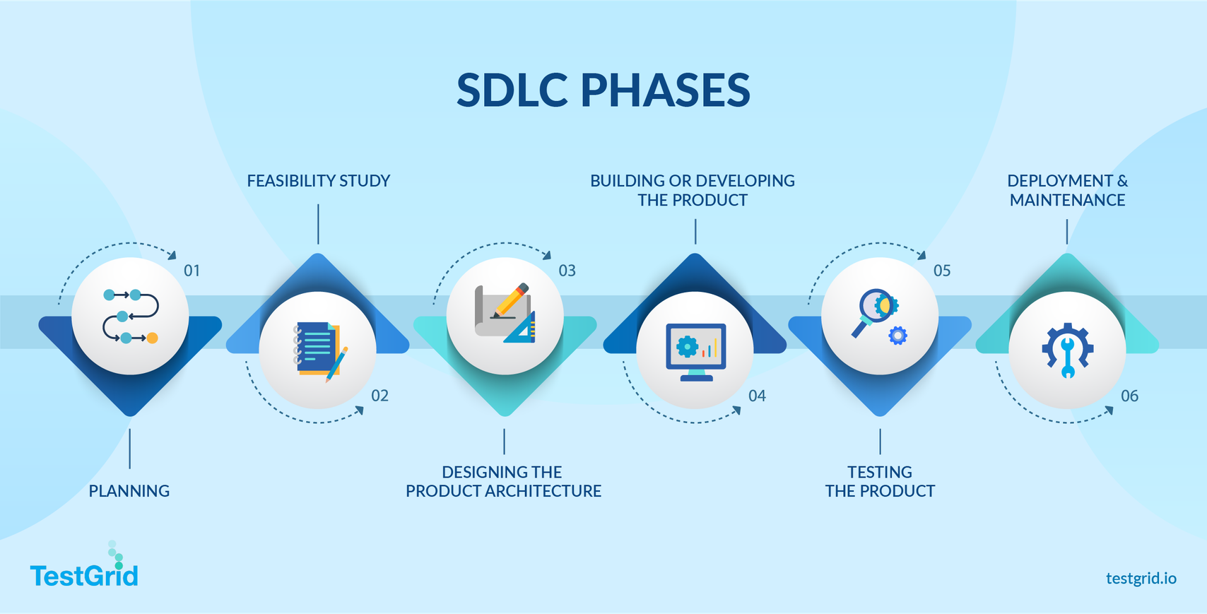
SOFTWARE DEVELOPMENT LIFE CYCLE (SDLC)
The Software Development Life Cycle (SDLC) is a structured process used to design, develop, test, deploy, and maintain software efficiently. It provides a systematic approach that helps organizations deliver high-quality software on time, within budget, and with minimal risks.
SDLC PHASES :

Slide 4
WHY DO WE NEED NEUROFORGE?
PROBLEMS WITH TRADITIONAL SOFTWARE DEVELOPMENT
  Teams rely on multiple tools for project management, coding, testing, and documentation, leading to fragmented workflows and reduced collaboration.
  Poor communication between business teams, developers, and testers often results in misunderstandings, delays, and frequent rework.
  Documentation is created and updated manually, making it time-consuming and prone to becoming outdated.
  Manual testing increases the time required to identify defects, slowing down software releases and delivery.
  Without automated code reviews, coding errors and security vulnerabilities may remain undetected until later stages.
  Managers often lack real-time visibility into project progress, resource allocation, and overall team productivity.

Slide 5
WHY DO WE NEED NEUROFORGE?
OBJECTIVES OF NEUROFORGE
  Enables seamless communication and coordination between developers, testers, project managers, and stakeholders on a unified platform.
  Uses AI and automation to perform coding, testing, documentation, and deployment tasks, saving time and reducing manual effort.
  Improves code quality through automated testing, code reviews, and early detection of bugs and security vulnerabilities.
  Streamlines workflows and minimizes rework, enabling faster project completion while lowering overall development costs.
  Provides live insights into project progress, team performance, bug tracking, and development status for better decision-making.
  Integrates AI with CI/CD pipelines and DevOps tools to automate development and deliver software faster and more efficiently.

Slide 6
CORE FEATURES AND FUNCTIONAL MODULES
MAJOR FEATURES
Requirement Project Management
  Requirement collection and tracking
  User stories and sprint planning
  Agile, Scrum, Kanban, and Waterfall support
AI-Powered Development
  AI-assisted requirement analysis
  AI code generation
  Automatic documentation
  Intelligent code suggestions
Source Code Management
  Git integration
  Branch and version control
  Pull requests and code reviews
Testing & Quality Assurance
  Unit, Integration, System, and
Regression Testing
  AI-generated test cases
  Automated bug detection
  Code quality analysis
Deployment & Monitoring
  CI/CD automation
  Cloud deployment
  Real-time monitoring
  Performance analytics
  Log management

Slide 7
BENEFITS OF NEUROFORGE
Increased Productivity
  Automates coding, testing, documentation, and deployment.
  Allows developers to focus on innovation instead of repetitive tasks.
Improved Collaboration
  Provides a centralized platform where all teams work together.
  Improves communication and requirement traceability.
Faster Software Delivery
  Continuous Integration and Continuous Deployment (CI/CD) reduce release time.
  Automated workflows eliminate manual delays.
Better Software Quality
  Automated testing and AI-based code reviews reduce bugs.
  Security vulnerabilities are detected early.
Cost Reduction
  Reduces rework and manual effort.
  Minimizes tool licensing costs by integrating multiple services into one platform.

Slide 8
TECHNOLOGY STACK
Frontend
  React.js
  Angular
  Vue.js
  HTML5
  CSS3
  TypeScript
Backend
  Java Spring Boot
  Node.js
  Python (FastAPI)
Database
  PostgreSQL
  MySQL
  MongoDB
  Redis
DevOps & Cloud
  Git, GitHub, GitLab
  Docker
  AWS

Slide 9
THANK YOU
VERY MUCH

